Slide 1

Bank Churn Prediction
Shreyash vishwakarma
© All rights reserved by Fireblaze Technologies Pvt. Ltd.

Slide 2
Problem Statement
Customer Churn: The loss of customers is a significant challenge for banks, impacting revenue and growth.
Proactive Retention: Identifying customers at risk of churning allows banks to implement targeted retention strategies.
Goal: To build a robust machine learning model that can accurately predict which customers are likely to exit the bank.
Benefit: Enables timely intervention, improves customer satisfaction, and reduces customer attrition costs..
© All rights reserved by Fireblaze Technologies Pvt. Ltd.

Slide 3
About the Data
Dataset: Bank Churn Prediction.csv
Source: Contains anonymized customer data from a bank.
Size: 10,000 rows, 14 columns.
Key Features:
Numerical: CreditScore, Age, Tenure, Balance, NumOfProducts, EstimatedSalary.
Categorical: Geography (France, Spain, Germany), Gender (Male, Female).
Binary: HasCrCard, IsActiveMember.
Target Variable: Exited (0 = Not Churned, 1 = Churned).
Data Quality: No missing values or duplicate rows found
© All rights reserved by Fireblaze Technologies Pvt. Ltd.

Slide 4
Proposed Solution
Approach: Utilize machine learning algorithms to identify patterns in customer behavior and demographics that lead to churn.
Methodology: Exploratory Data Analysis (EDA): Understand data characteristics, distributions, and relationships.
Data Preprocessing: Prepare data for machine learning models (handling categorical features, scaling numerical features).
Model Building: Train and evaluate multiple classification models.
Performance Evaluation: Compare models using relevant metrics.
© All rights reserved by Fireblaze Technologies Pvt. Ltd.

Slide 5
Proposed Solution
Approach: Utilize machine learning algorithms to identify patterns in customer behavior and demographics that lead to churn.
Methodology:
Exploratory Data Analysis (EDA): Understand data characteristics, distributions, and relationships.
Data Preprocessing: Prepare data for machine learning models (handling categorical features, scaling numerical features).
Model Building: Train and evaluate multiple classification models.
Performance Evaluation: Compare models using relevant metrics.
© All rights reserved by Fireblaze Technologies Pvt. Ltd.

Slide 6
Descriptive Analysis
Key Statistics:
Average Age of customers: ~39 years.
Average CreditScore: ~650.
Mean Balance: ~76,486, but many customers have zero balance.
Mean EstimatedSalary: ~100,090.
Target Variable Skewness:
Approximately 20.37% of customers have churned (Exited = 1), indicating a class imbalance.
Feature Observations:
RowNumber, CustomerId, and Surname are unique identifiers and are irrelevant for prediction.
© All rights reserved by Fireblaze Technologies Pvt. Ltd.

Slide 7
Data Preprocessing
Irrelevant Column Removal:
Dropped RowNumber, CustomerId, and Surname as they offer no predictive power.
Categorical Encoding:
Geography and Gender columns were converted into numerical format using One-Hot Encoding to prevent ordinality assumptions and ensure proper model interpretation.
© All rights reserved by Fireblaze Technologies Pvt. Ltd.

Slide 8
Data Preprocessing
Feature Scaling:
Numerical features (CreditScore, Age, Tenure, Balance, NumOfProducts, HasCrCard, IsActiveMember, EstimatedSalary) were scaled using StandardScaler. This standardizes their range, which is crucial for distance-based algorithms (like KNN) and beneficial for others.
Data Splitting:
The dataset was divided into 80% training data and 20% testing data to evaluate model performance on unseen data.
Stratified splitting was used to maintain the proportion of churned/non-churned customers in both training and test sets.
© All rights reserved by Fireblaze Technologies Pvt. Ltd.

Slide 9
Data Visualization and key findings
Here's what we discovered through our analysis, with descriptions of the charts your code generates:
Distribution of Customer Features (Numerical)
What These Charts Show: For each numerical piece of information (like Credit Score, Age, Tenure, Balance, Number of Products, and Estimated Salary),
© All rights reserved by Fireblaze Technologies Pvt. Ltd.

Slide 10
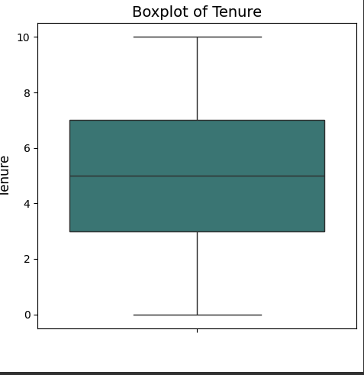
Data Visualization and key findings
you'll see two charts:
Histograms: These show how often different values appear. You can see if most customers have a certain credit score, or if ages are spread out evenly
Box plots: These give you a quick summary of the data's spread, showing the typical range of values and any unusually high or low numbers (outliers).
© All rights reserved by Fireblaze Technologies Pvt. Ltd.

Slide 11
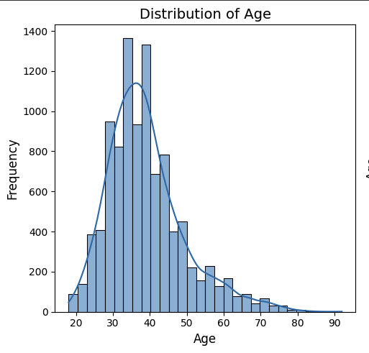
Data Visualization and key findings
What We Learn:
These help us understand the makeup of our customer base for each key financial and demographic aspect. For example, we can see if most customers are young or older, or if their balances are concentrated at certain amounts.
© All rights reserved by Fireblaze Technologies Pvt. Ltd.

Slide 12
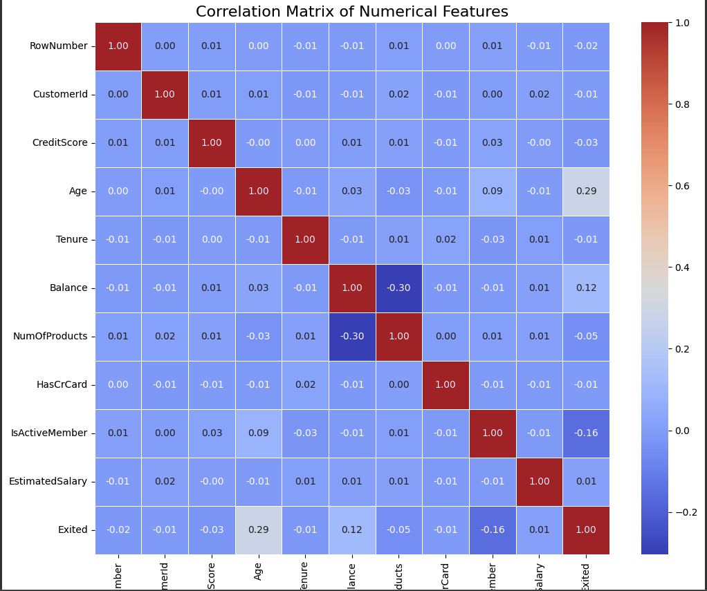
Data Visualization and key findings
How Features Relate to Each Other (Correlation Matrix)
What This Chart Shows: This is a colorful grid that shows how strongly each numerical feature is connected to every other numerical feature.
Bright colors (like deep red or deep blue) mean a strong connection.
Colors close to the middle means there's little to no direct connection.
© All rights reserved by Fireblaze Technologies Pvt. Ltd.

Slide 13
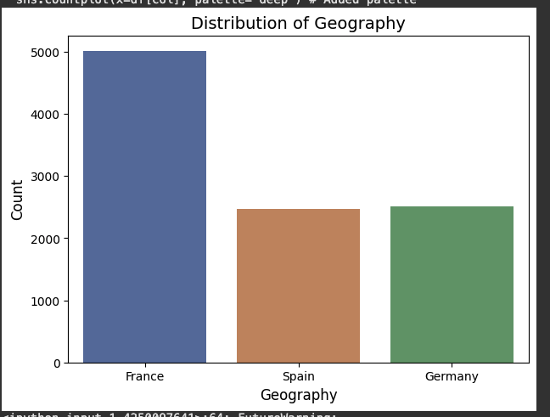
Data Visualization
Geography vs. Churn:Germany shows a noticeably higher count rate compared to France and Spain.
Gender vs. Churn:Female customers exhibit a slightly higher churn rate than male customers.
Active Member vs. Churn:Inactive members have a higher propensity to churn.
Correlations: Positive correlation of Age and Balance with Exited.

Slide 14
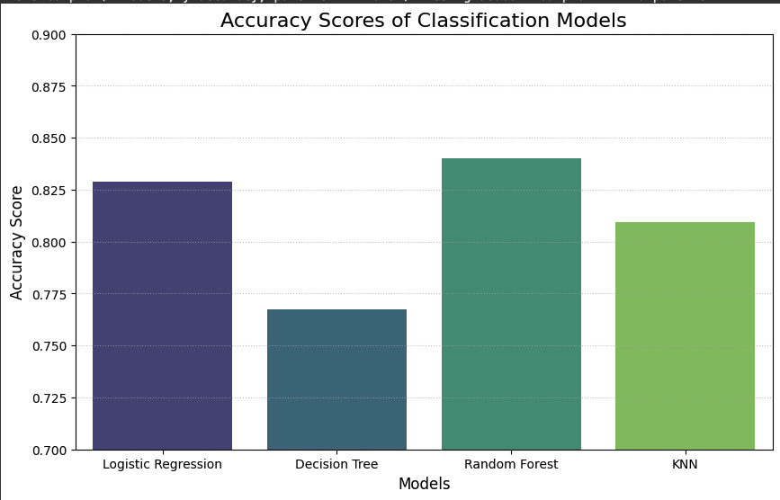
Machine Learning Modeling & accuracy
Models Implemented:
Logistic Regression
Decision Tree Classifier
Random Forest Classifier
K-Nearest Neighbors (KNN) Classifier
Simple Linear Regression (adapted for classification)
Multiple Linear Regression (adapted for classification)
© All rights reserved by Fireblaze Technologies Pvt. Ltd.

Slide 15
Conclusion
The project successfully developed a machine learning solution for bank churn prediction.
Exploratory Data Analysis provided valuable insights into customer behavior and churn drivers.
Data preprocessing steps ensured the data was ready for robust model training.
Among the evaluated models, the Random Forest Classifier proved to be the most effective, achieving an Accuracy of 85.8%
This model can empower banks to identify at-risk customers proactively, allowing for timely and targeted retention efforts, ultimately leading to improved customer loyalty and reduced churn.
© All rights reserved by Fireblaze Technologies Pvt. Ltd.

Slide 16
Future Scope
Feature Engineering: Explore creating new features from existing ones (e.g., age groups, balance-to-salary ratio) to potentially enhance model accuracy.
Explore Other Models: Investigate more advanced models like Gradient Boosting (XGBoost, LightGBM) or Neural Networks.
A/B Testing: Design experiments to test the effectiveness of retention strategies based on model predictions.
Deployment: Consider deploying the model as an API for real-time churn prediction within the bank's systems.
Interpretability: Further analyze model interpretability to gain deeper insights into specific customer attributes driving churn.
© All rights reserved by Fireblaze Technologies Pvt. Ltd.

